Slide 1

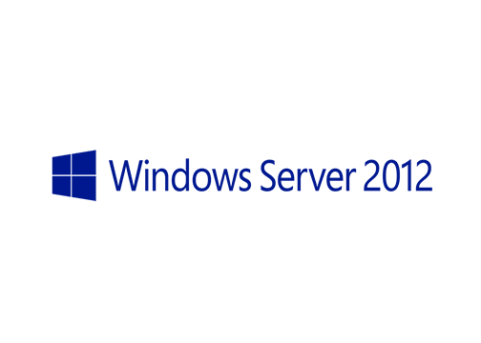
MegaSeries
Create a Group Managed Service Account with Powershell

Slide 2
Info
New feature added in Windows Server 2012
A much better version a the Managed Service Accounts
gMSAs have their password managed by Active Directory
A gMSA, compared to a MSA, can be installed and used on one or more servers

Slide 3
Supported on
Windows Server 2012/Windows 8 and up
Can be used with: Services, Scheduled Tasks and IIS

Slide 4
Steps to create and use a gMSA
Create a new Key Distribution Service (used to generate gMSA passwords); done only once
(Optional) Create a group and add computers that shuld use the gMSA to it
Create a gMSA and permit individual hosts or groups to be able to retrieve the password
Install the gMSA on
Configure the service/scheduled task/IIS app pool with the gMSA

Slide 5
https://www.youtube.com/channel/UCcZ-jLbPwNr8E_v9-65n8Iw https://github.com/itknowledge4

